Slide 1
Lecture 3
Topics
Firm Costs
Total cost
Average cost
Marginal cost
Sunk cost
Opportunity cost
Readings
Varian, Chapter 21

Slide 2
Notes
Reminder: to participate in instant polls and chats during this class, please connect to zoom via the link on Canvas (https://canvas.cmu.edu/)
Reminder: you will need to be on Canvas (https://canvas.cmu.edu/) also to complete the short assessments
Laptops: use only for note taking/Canvas/Zoom

Slide 3
Notes
HW teams
HW1
Corrected typo in Q2.d: “printers” should be “smart thermostats”
Quiz 1
X

Slide 4
Review
Markets and Efficiency
Demand
Supply
Elasticity
Equilibrium
Efficiency

Slide 5

Today’s objectives
Analyze the differences among various types of costs (and cost functions) that firms face when producing goods and services

Slide 6
Production and costs
Firms produce goods or services (output) using a variety of factors of productions (inputs)
Factors of production usually must be paid for
Hence, firms incur costs to produce output

Slide 7
Fixed vs. variable costs in the short vs. long run
A fixed cost is any cost that a firm bears in the short run that does not depend on its level of output. These costs are incurred even if the firm is producing nothing
E.g., for Mr “Dall,” a manufacturer of computers, fixed costs may include the price of leasing the factories where computers are manufactured (assuming the number of factories cannot be changed in the short run)
A variable cost is any cost a firm bears that depends on the level of production chosen
E.g., for Mr Dall, variable costs could include the price of the silicium used to manufacture each of its chips
There are no fixed costs in the long run! All factors (including factors that were “fixed” in the long run) are now variable
What constitutes a “long run” depends on the industry/market/scenario being analyzed: we could even say that the long run (or long term) is when all costs are variable

Slide 8
Cost functions
The cost function c(y) represents the relation between units produced, y, and the cost to produce them, c:
This relation depends on the technology used to produce the goods (i.e., the production function), the prices of the factors of production, and so forth
Example of a production function: Y=f(K,L)
y is product, K is capital, L is labor, f represents the technology
Note: we will use y and q almost interchangeably
Note: It is assumed that cost functions show the cost of production using the best available technique at each output level, given factor prices

Slide 9
Cost functions
Cost functions are often written as
c(y) = a + by + cy² + dy³ + …
In fact, we will often use linear costs in this course
c(y) = a + by
What is the fixed cost here? What is the variable cost?
The “total” cost function (or just “cost function”) is indeed the sum of the fixed cost function and the variable cost function:
c(y) = FC(y) + VC(y)
If you replace y with the actual quantity produced, you will be able to calculate the total costs of production at that quantity
Costs (or “total costs”) = Fixed Costs + Variable Costs

Slide 10
Average cost functions
The average cost function AC(y) represents the costs per unit of output
The average variable cost function AVC(y) measures the variable costs per unit of output
The average fixed cost function AFC(y) measures the fixed costs per unit output
Remember that c(y) = VC(y) + FC(y)
Therefore, c(y)/y = VC(y)/y + FC(y)/y
Which we can write equivalently as: AC(y) = AVC(y) + AFC(y)

Slide 11
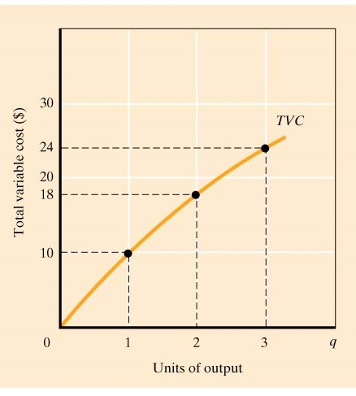
Cost curves
We can draw cost functions using cost/quantity diagrams. For instance, the variable cost (VC) curve is a graph that shows the relationship between the total variable cost and the level of a firm’s output
As a reminder, also the VC curve shows the cost of production using the best available technique at each output level, given current factor prices

Slide 12
Cost functions and cost curves: Example
Mike has just founded Dall, a company that produces desktop computers
He spends $100 to produce each computer
Mark also spends $4,000 to use (lease) the building in which he produces his computers
Write down the following:
Mark’s cost functions (e.g., c(y), AVC(y), etc.)
A table showing the numerical costs (total, variables, fixed, average…) at various possible output levels
A plot of the functions (i.e. cost curves):
What is happening to AFC (as well as ATC)?
X

Slide 13
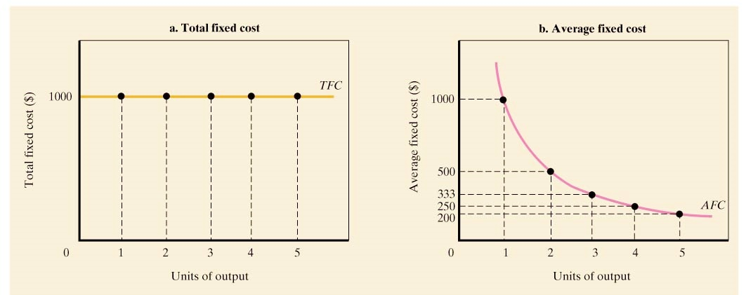
Short run fixed cost of a hypothetical firm
X

Slide 14
Marginal cost (MC)
The marginal cost measures the change in costs for a given change in output:
MC = Δc(y)/ Δy
Most often, we consider Δy=1, in which case the MC measures the additional cost required to produce one more unit
Suppose Mike is producing 3,000 computers. Given his cost function, what is his MC(3,001)?
X

Slide 15
Marginal cost (MC)
Note: marginal costs reflect changes in variable costs
Δc(y)/Δy
But we can also calculate: dc(y)/dy
When calculated using the derivatives, the marginal cost is a function representing the instantaneous rate of change of the cost function with respect to the production at a given production level
Hence, the value of the MC calculated using the derivative is correct only for local, small changes (similar to the elasticity calculated using the derivative of the demand function)
Slope of VC and slope of TC are both = MC

Slide 16
Another example: A very simple cost function
Suppose c(y) = 1 + y²
FC =
VC =
AFC =
AVC =
ATC =
MC =
X

Slide 17
Marginal product (MP)
The marginal product of a productive factor measures the change in (units of) output for a given change in (units used of) that productive factor

Slide 18
Increasing marginal costs/ Decreasing marginal product
In the short run, most firms are often constrained by some fixed input (i.e. productive factor)
As the firm get closer to maximum capacity, it becomes increasingly hard and costly to produce more output
When other productive factor(s) is/are being held fixed, the marginal product of a factor often diminishes as we use more and more of that factor
This means that, in the short run, the marginal product of a productive factor often decreases in the amount of that factor used in production – total product still increases (if MP>0), but at decreasing rates
Hence, in the short run, marginal costs often ultimately increase with output
Note: the marginal cost curve often will be somewhat U-shaped
(Not always, though: see the marginal cost in the previous slide)

Slide 19
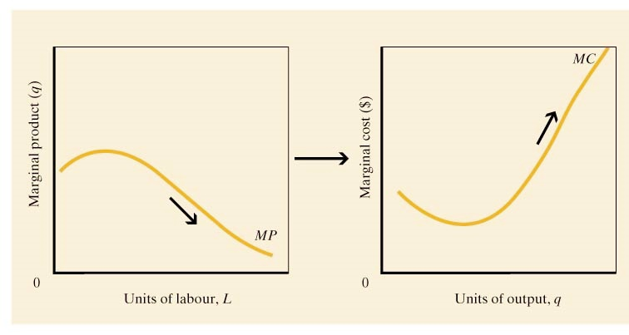
Declining MP implies that MC rises with output
Note: Total product keeps increasing even when Marginal product is decreasing (as long as MP is positive)

Slide 20
The relation between AVC and MC
First, note that MC(1) = AVC(1)
(For discrete changes, i.e. first unit produced)
Often (but not always), average variable costs curve are U-shaped: average variable costs first fall, then increase
At output levels where the average variable costs are falling, marginal costs must be less than the average variable costs. At output levels where the average variable costs are rising, marginal costs must be larger than average variable costs
Hence MC curve intersects AVC curve at its point of minimum
Note: the above is true also for ATC!

Slide 21
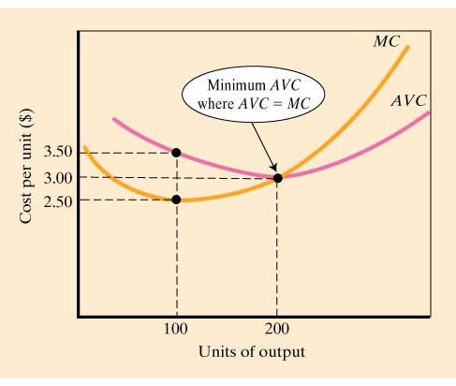
AVC and MC

Slide 22
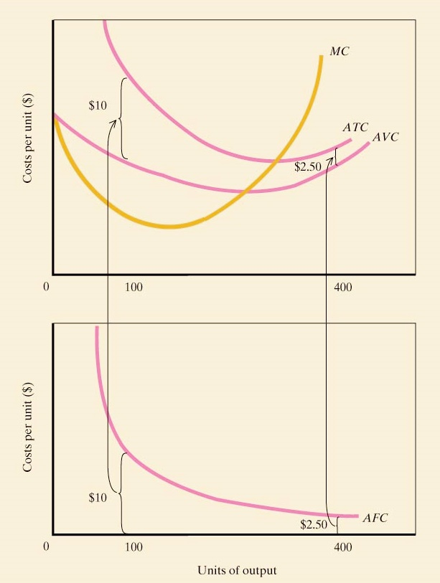
ATC, AVC, and MC
Marginal cost crosses both AVC and ATC at their minimum values
AVC and ATC get closer together as output increases since AFC falls as output rises, but they never cross

Slide 23
What happens in the long run?
In the long run, there are no fixed costs
All factors of production, even those that were “fixed” in the short run, are now variable
In other words, the long run cost functions capture the relationship between quantity and costs when the firm can vary all factors of production
Thus, all costs are variables costs
For each output level, the long run ATC will be equal to or lower than the short run ATC, because in the long run, all inputs are variable:
Say you have a fixed factor such as land, “L”
You can always choose L in the long run to be equal to the fixed L used in the short run when L is fixed and have average cost equal to short run ATC; but choosing a different L (when L is variable) might yield lower costs
The shape of long-run average cost function will depend on economies of scale – see forthcoming Lecture

Slide 24
Two final (but important!) concepts
Sunk costs: sunk costs are those costs that have already been incurred are beyond recovery at the moment a decision is made. These costs should be ignored in evaluating that decision
Opportunity costs: For businesses and people, an opportunity cost is the value of the next best alternative that must be foregone in order to undertake an activity. (Motivation: The cost of a choice can be expressed in terms of an opportunity foregone. The value of your choice should be compared to the value of your next best alternative.)

Slide 25
How do companies cut costs?
Reduction of process costs
Reduction in costs of materials/productive factors
Technology (including IT)
Relocation
Mergers
Layoffs
…

Slide 26
Summary
Firm Costs
Total
Average cost
Marginal cost
Sunk cost
Opportunity cost

Slide 27
Next lecture
Topics
Perfect Competition
Readings
Varian, Chapters 22 and 23

Slide 28
Solutions to cost problems
Dall: c(y) = 4,000 + 100 y
Dall: MC(3001) = 100
Specific cost curve C(y) = 1 + y² :
1
y^2
1/y
Y
y+1/y
2y

